Slide 1
Lecture 5

Slide 2
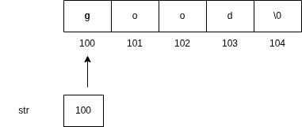
Pointers And Character String
char str[] = “good”;
char *str = “good”;

Slide 3
printf(“%s”, str);
puts(str)
Although str is a pointer to the string, it is also the name of the string.Therefore we don’t need indirection operator * .
Find the length of string using pointer

Slide 4
Array of Pointers
The following line of code will reserve 75 bytes of memory.
char name[3][25];
char *name[3] = { “New Zealand”, “Australia”, “India”};
Name[0] -> New Zealand
Name[1] -> Australia
Name[2] -> India
Only 28 Bytes are needed to hold all the characters.

Slide 5
The following statement would print all the three names.
for(i = 0; i < 3; i++)
printf(“%s”, name[i]);
Difference b/w *p[3] and (*p)[3]. Since * has lower precedence than [].
*p[3] will declares p as an array of 3 pointers while (*p)[3] declares pointer to an array of three elements.

Slide 6
Function that returns multiple values
void mathoperation(int a, int b, int *sum, int *diff){
*sum = a+b;
*diff = a - b;
}

